Slide 1
Air Quality Project
Assignment 2: Choosing your Site
And Intro to Assignment 6: Final Presentation and Media Piece

Slide 2
Today’s Agenda
Make teams
Select a site or site(s) to investigate
Familiarize yourself with EPA and EEA Guidelines on Air Quality
Read a case study and understand air quality reports and investigations
Begin researching your site

Slide 3
Looking Ahead: Final Project
Read through the final project description on Canvas or in the class drive!
Note the main components:
Potential Topics
Peer “Conference” Presentation week after
Media Piece for Gala Showcase at end of term
Also, Preliminary Presentation next week (more on that tomorrow)
Questions?

Slide 4
Making Teams and Signing Up
Teams of 2-3 students
Once you have your team, go to the sign up sheet in the Drive (and linked on Canvas) and put your names down next to the site you want to investigate
Create a copy of the Assignment 2 document to be a team submission and write down your team names and your site name(s)

Slide 5
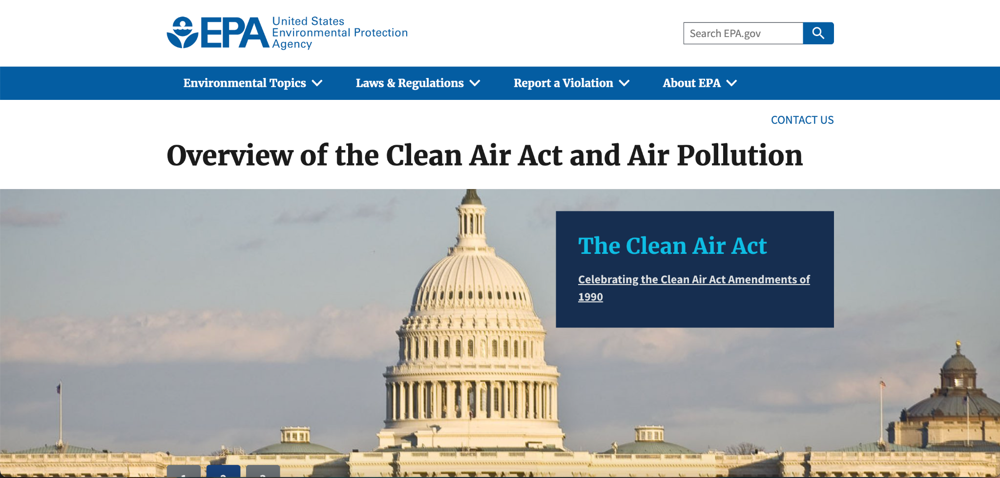
EPA Guidelines
Click around the Environmental Protection Agency’s Air Quality Regulations
Summarize your findings about US air quality regulations. Your site is not in the US, but you can apply the EPA’s regulations to it as an exercise
Notes:
Skippable, can be done independently

Slide 6
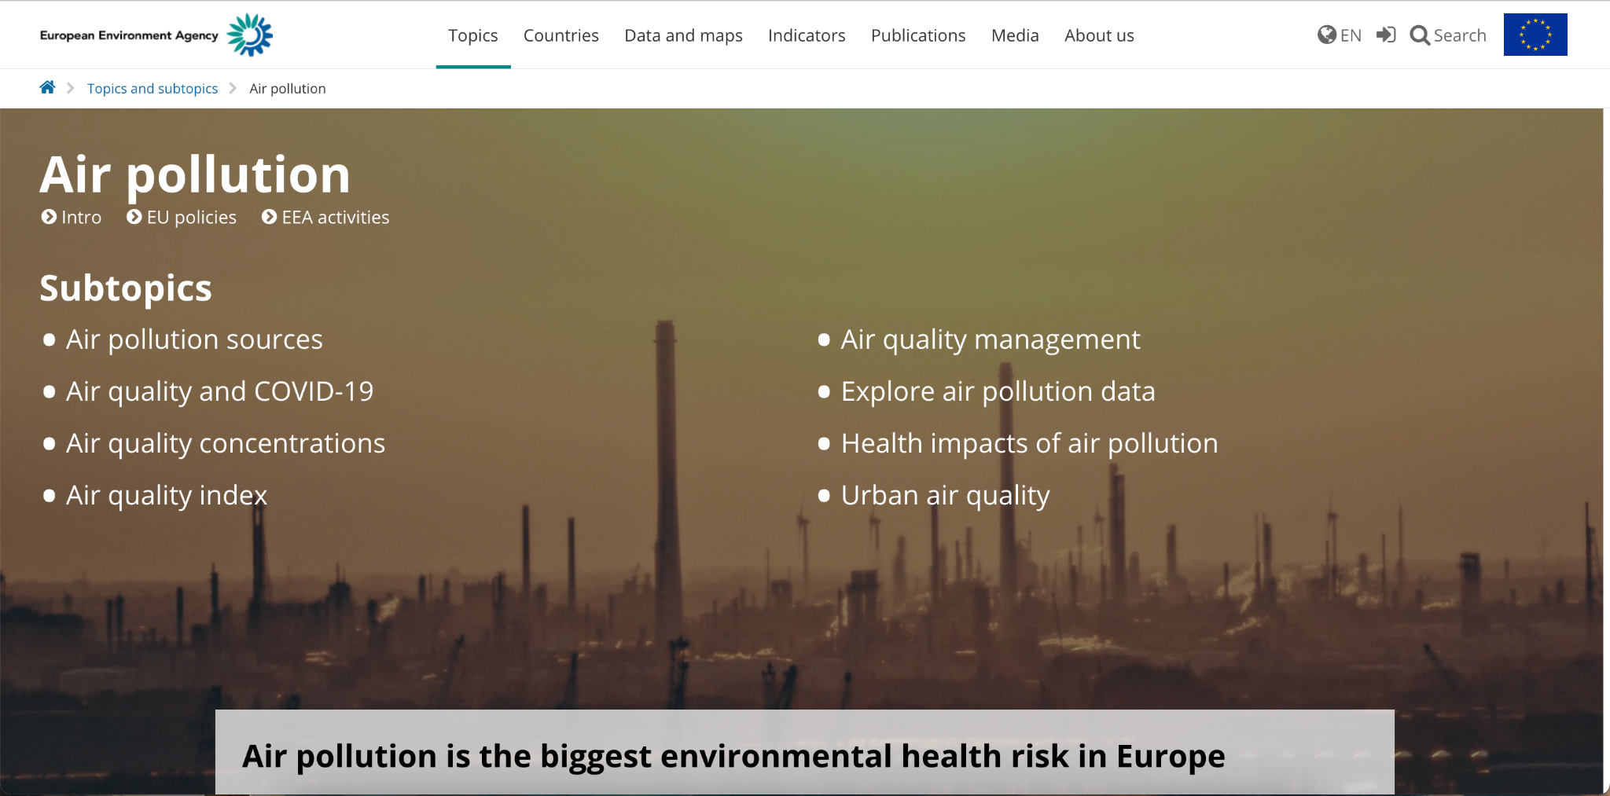
EEA Guidelines
Click around the European Environment Agency’s Air Quality Regulations
Summarize your findings about EU air quality regulations. Especially note anything that might be relevant to your site, your pollutants, or your project.
Notes:
Skippable, can be done independently

Slide 7
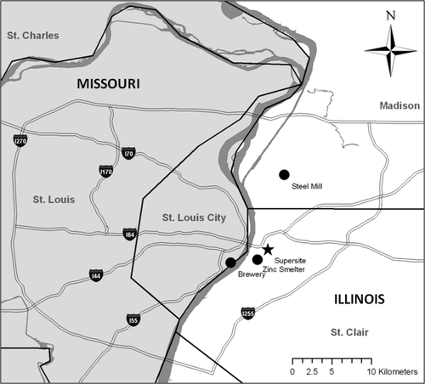
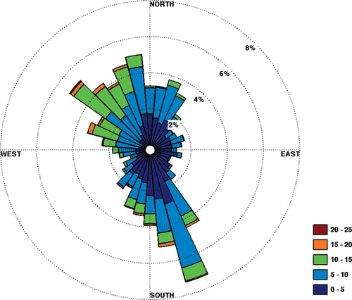
Case Study
Answer the questions corresponding to these figures as a group:
Notes:
Nice to look at as a class potentially

Slide 8
Case Study (con’t)
Now read the article that these figures came from: “Source Region Identification Using Kernel Smoothing,” by Henry et al.
Answer the reading questions in your answer sheet as a group
Notes:
Skippable, can be done independently

Slide 9
Research Your Site
Using what you’ve found about environmental guidelines and modern air quality research, begin to research your site.
Record some preliminary research findings in your answer sheet. Assemble a “major source” list and submit at least 3 sources with your answer sheet. You can of course continue to research your site beyond the time in this class.
Notes:
Skippable, can be done independently

Slide 10

Share with the Class!
Exit Question: what topic is your team leaning towards? Describe what you’re interested in investigating in 1 minute or less.
https://strongcitiesnetwork.org/en/city/berlin-germany/

